Slide 1
Cleaning and
Formatting Data
Handling Missing values and Setting Data Formats
CS 171 – July 17, 2019
Jordan Atwell & Dr. Michael Peterson

Slide 2
NA Values
Sometimes datasets are too large or there are too many missing or unique values to perform feature imputation
R uses a special ‘NA’ value to represent missing values
May also use zero-length character strings for missing character data
Finding NA values
is.na()
Returns a TRUE or FALSE matrix or vector
Removing NA values
na.omit()
Removes rows containing NA values from the data frame
Use sparingly – it is often better to replace a few NA values with estimated replacements than to remove entire rows

Slide 3
Replacing With NA Values
Occasionally, you will find datasets that do not have NA values but really do
This can happen due to human error during data entry (ex: writing “NA” instead of leaving a space blank)
This can be fixed with replace_with_na() from the naniar package
To demonstrate, we’ll work with a data frame called “Pets”, which is a list of four people and the type of pet they own.

Slide 4
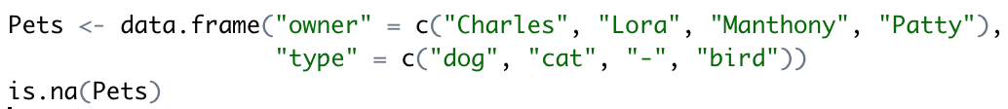
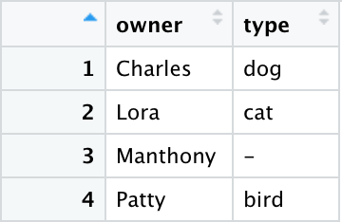
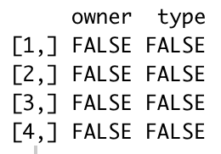
NA Values example
Pets
is.na(Pets) results

Slide 5

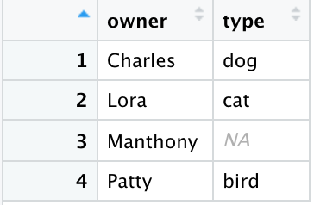
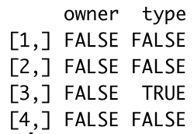
NA Values example
Pets
is.na(Pets) results

Slide 6

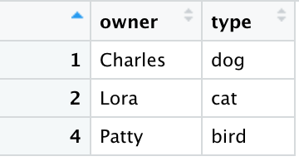
NA Values example
We only want responses from people with pets, so we will remove Manthony’s response.
Before
After

Slide 7
Before
replace_with_na
na.omit

Slide 8
Data Formatting
Goal: Organize data
Correctly formatting data makes it easier for computers to process data
One of the most common types of formatting is to set the correct data type
Data types:
Numeric
Character
Date
Time
There are more, but we will be focusing on these four.

Slide 9
R Formatting Functions
as.numeric
This function can create or change items into numeric ones
Typically from character to numeric
as.character
This function can create or change items into character data types
Typically changing things into characters or using it as a go-between
as.Date
This function can create or change items into “Date”
Typically character to date
chron
This function can create or change items into “Time”
Can also use chron to format date types, but it is a bit tricky

Slide 10
How to Use
as.numeric
number <- as.numeric(chrNumber)
as.character
character <- as.character(number)
as.Date
Date <- as.Date(chrDate, FORMAT)
FORMAT: Can be many different formats
chron
time <- chron(times = chrTime, format = (times = FORMAT))
FORMAT: Usually “h:m:s” or “h:m”

Slide 11
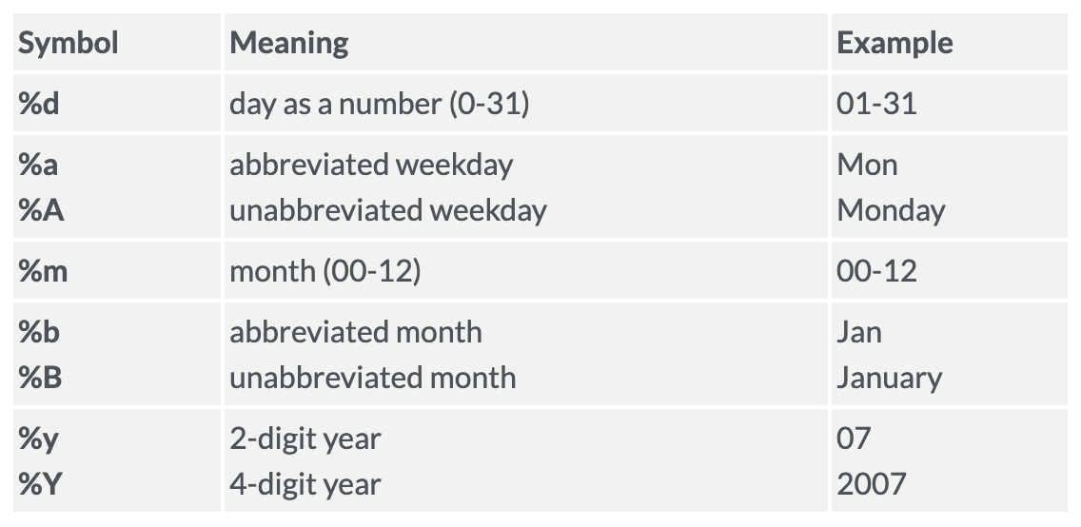
Formatting Symbols for as.Date
Notes:
Date format from https://www.statmethods.net/input/dates.html

Slide 12
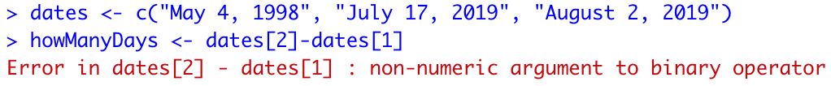
as.Date example
Input:
Output:

Slide 13
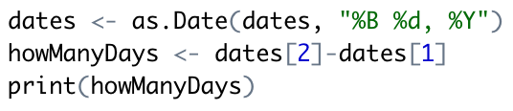
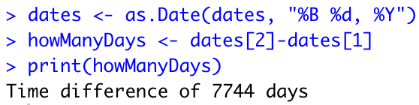
as.Date example (cntd.)
Input:
Output:

Slide 14
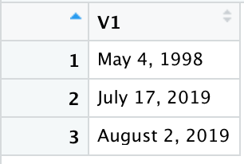
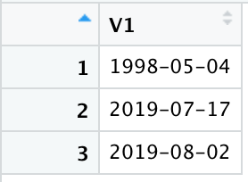
Before
After

Slide 15
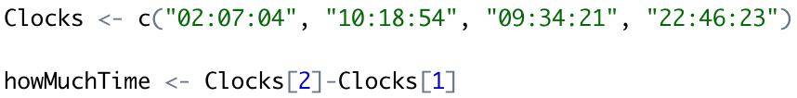
chron example
Input:
Output:

Slide 16

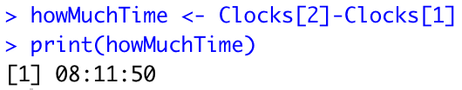
chron example (cntd.)
Input:
Output:

Slide 17
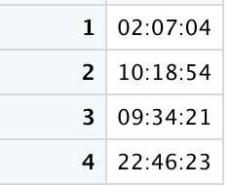
Before
After
There isn’t a lot of difference in how this data appears, but let’s take a look at the structure of the data

Slide 18
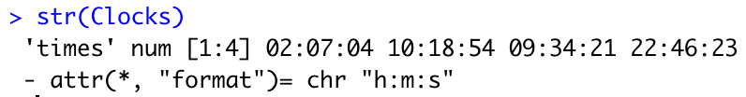
chron example
Before
After

Slide 19
Summary
Handling missing values and using proper data types are both important steps in the cleaning and handling of our data
By cleaning and formatting our data, it is much easier to analyze or use for creating visualizations
We’ll practice cleaning up NA values and formatting data types in Lab 7

